Slide 1
Chapter 9
Arithmetic and Logic Unit

Slide 2
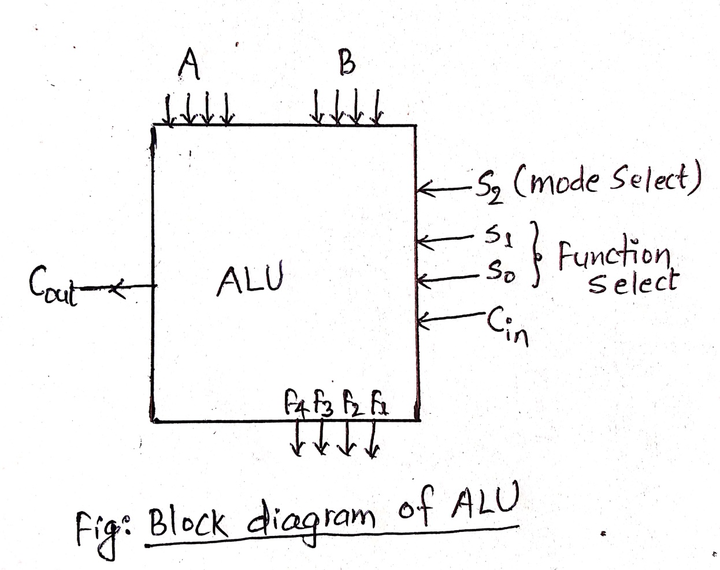
Arithmetic and Logic Unit
Deals with the calculation and processing.
Consists of 2 parts.
Arithmetic Unit:
-deals with the arithmetic operations of i/ps.
Logic Unit:
-deals with the logical operations of i/ps.

Slide 3
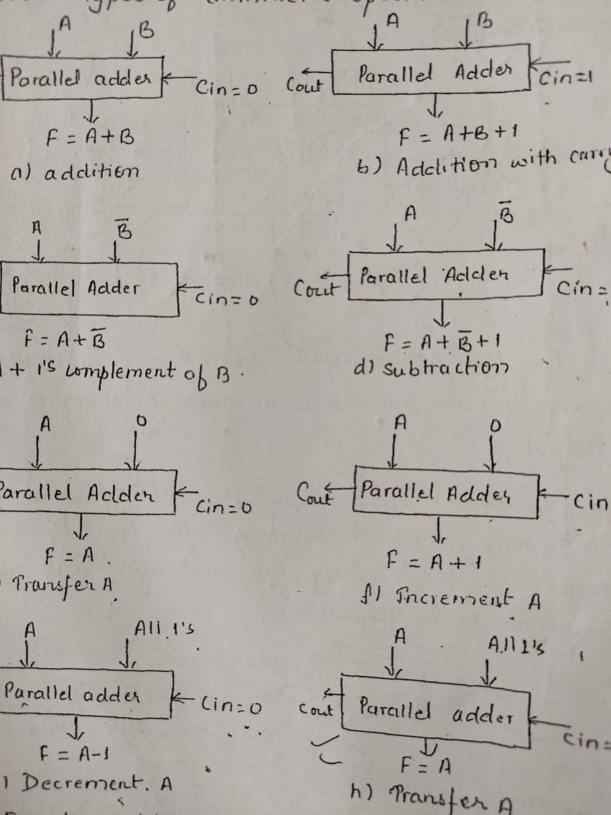
Eight different arithmetic operations
The different operations are:
F=A+B F=A+B+1
F=A+B‘ F=A+B‘+1
F=A+0’s F=A+0’s+1
F=A+1’s F=A+1’s+1
=A-1 =A

Slide 4
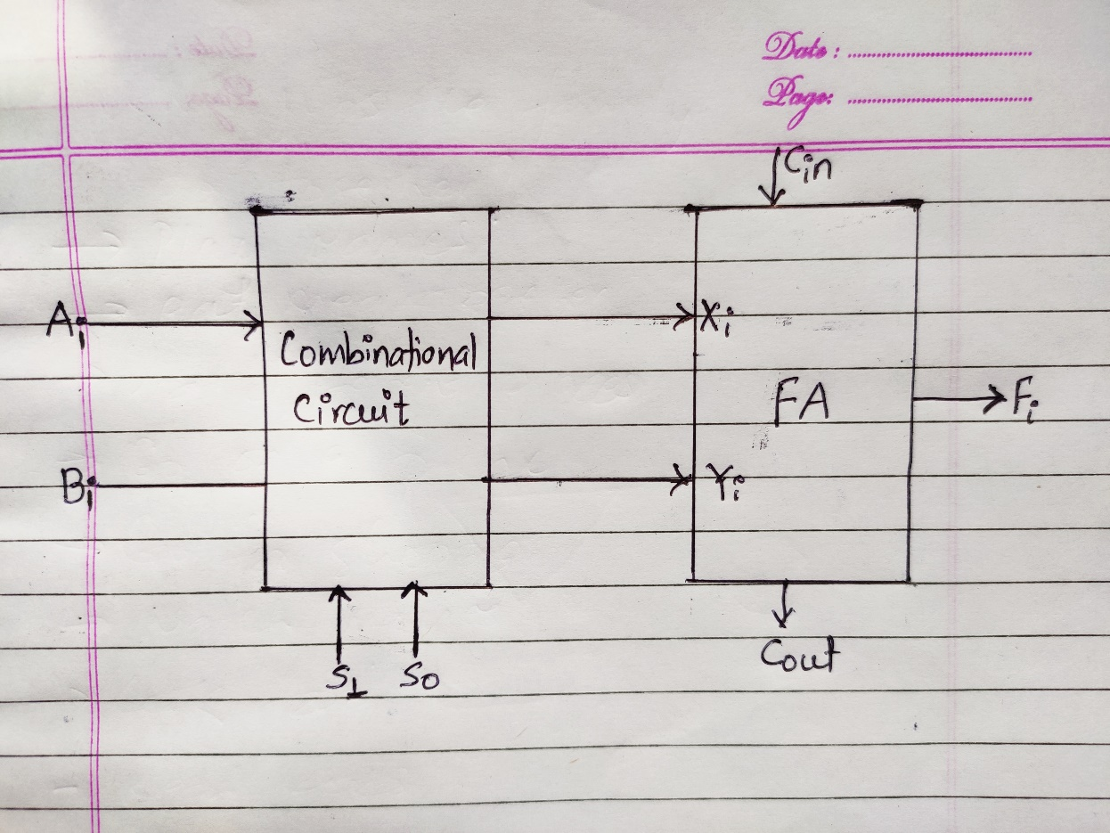
Design of Arithmetic Circuit
The block diagram of arithmetic circuit is as shown in figure along side.
Its design include the design of combinational circuit before the parallel adder.
The design starts with the specification or function table given.

Slide 5
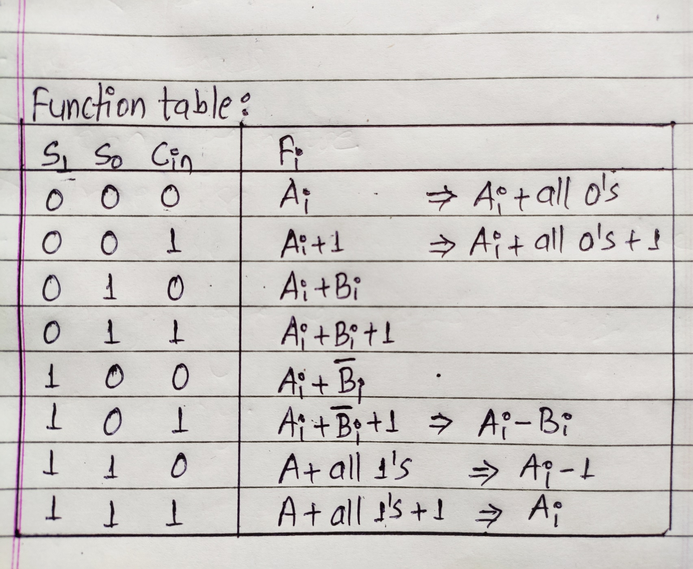
Function table;

Slide 6
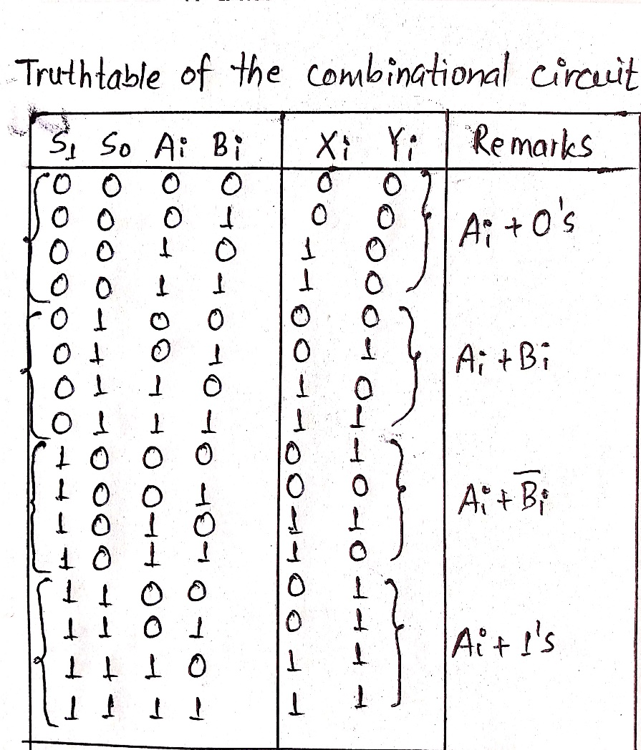
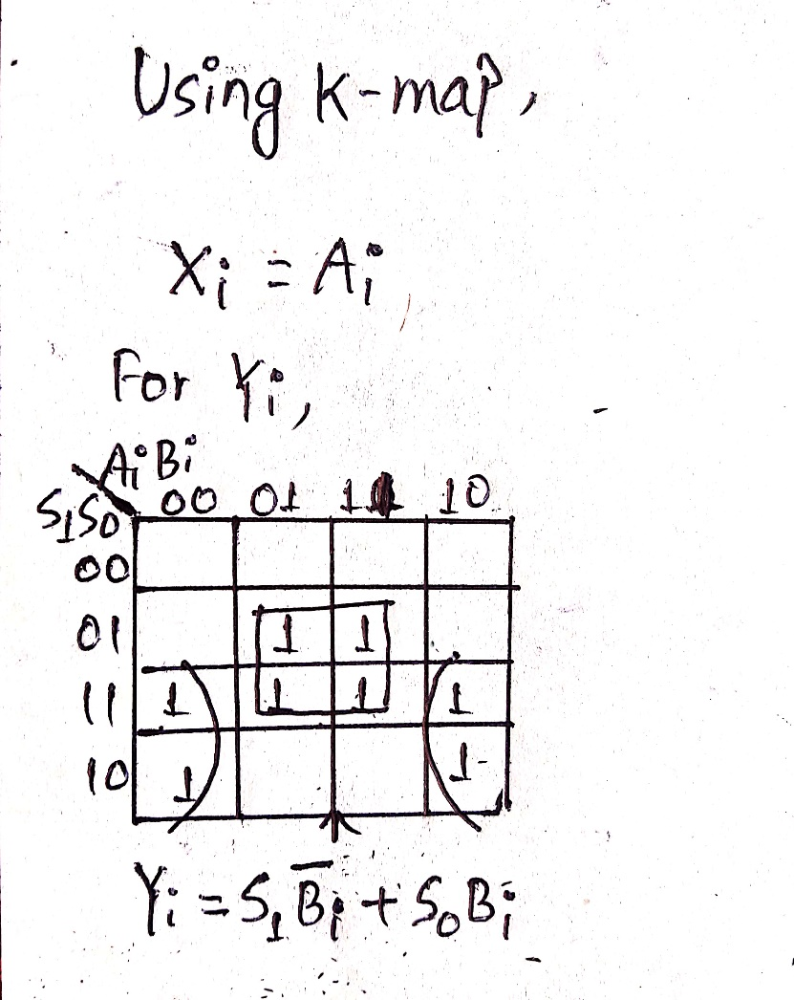
Truthtable of the combinational logic:

Slide 7
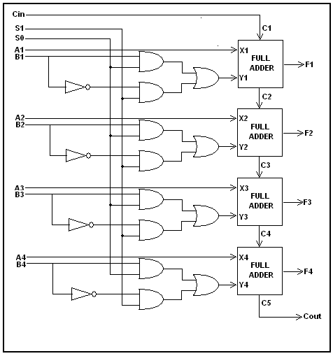
Circuit diagram of the 4 bit arithmetic circuit:

Slide 8
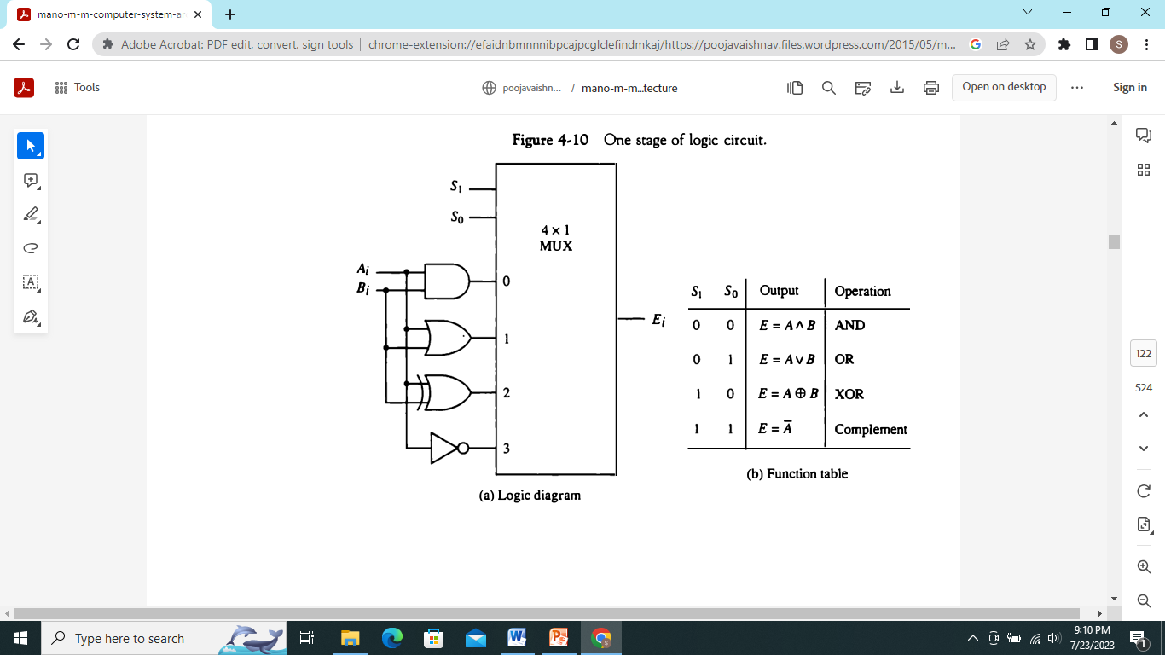
Design of Logic Unit:
Select variables:
S2 -> mode select
S1,S0 -> function select
Let the logical operations be:
OR,XOR,AND,NOT
For design, lets take a 4×1 MUX.

Slide 9
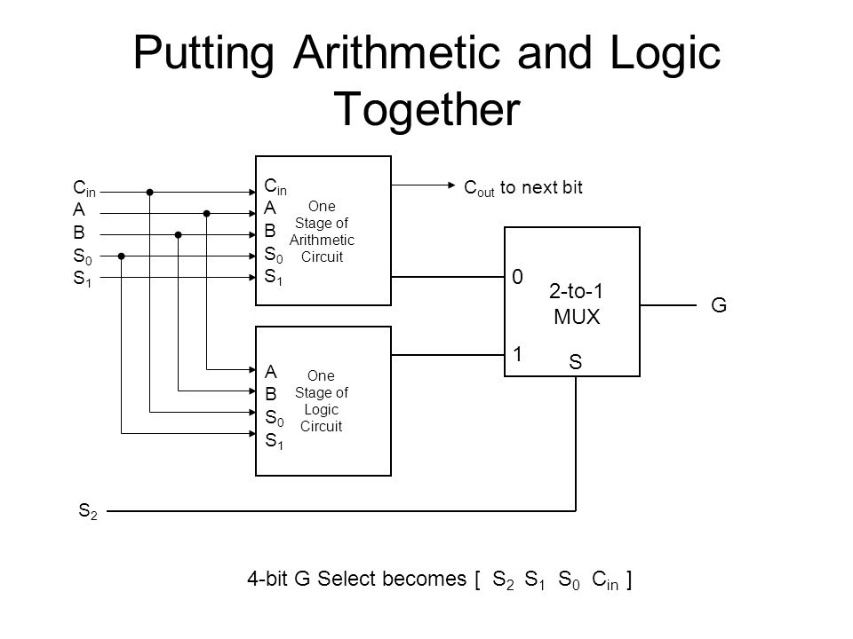
Single stage ALU:
Now combining both arithmetic and logic units we can draw or design ALU.
The single stage ALU is as shown along side.

Slide 10
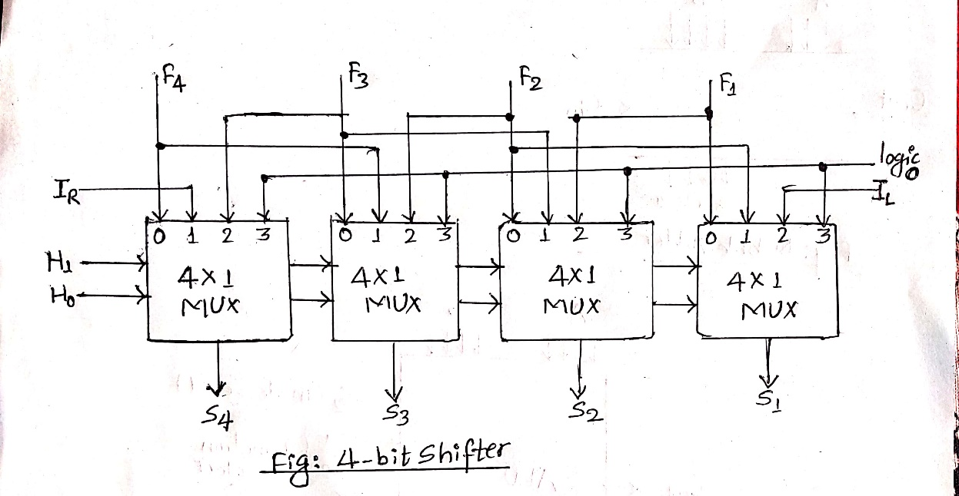
Design of Shifter:
Transfers the o/p of ALU to the bus.
It is a shift register with parallel load.
The circuit diagram and the function table is as shown in the figure.

Slide 11
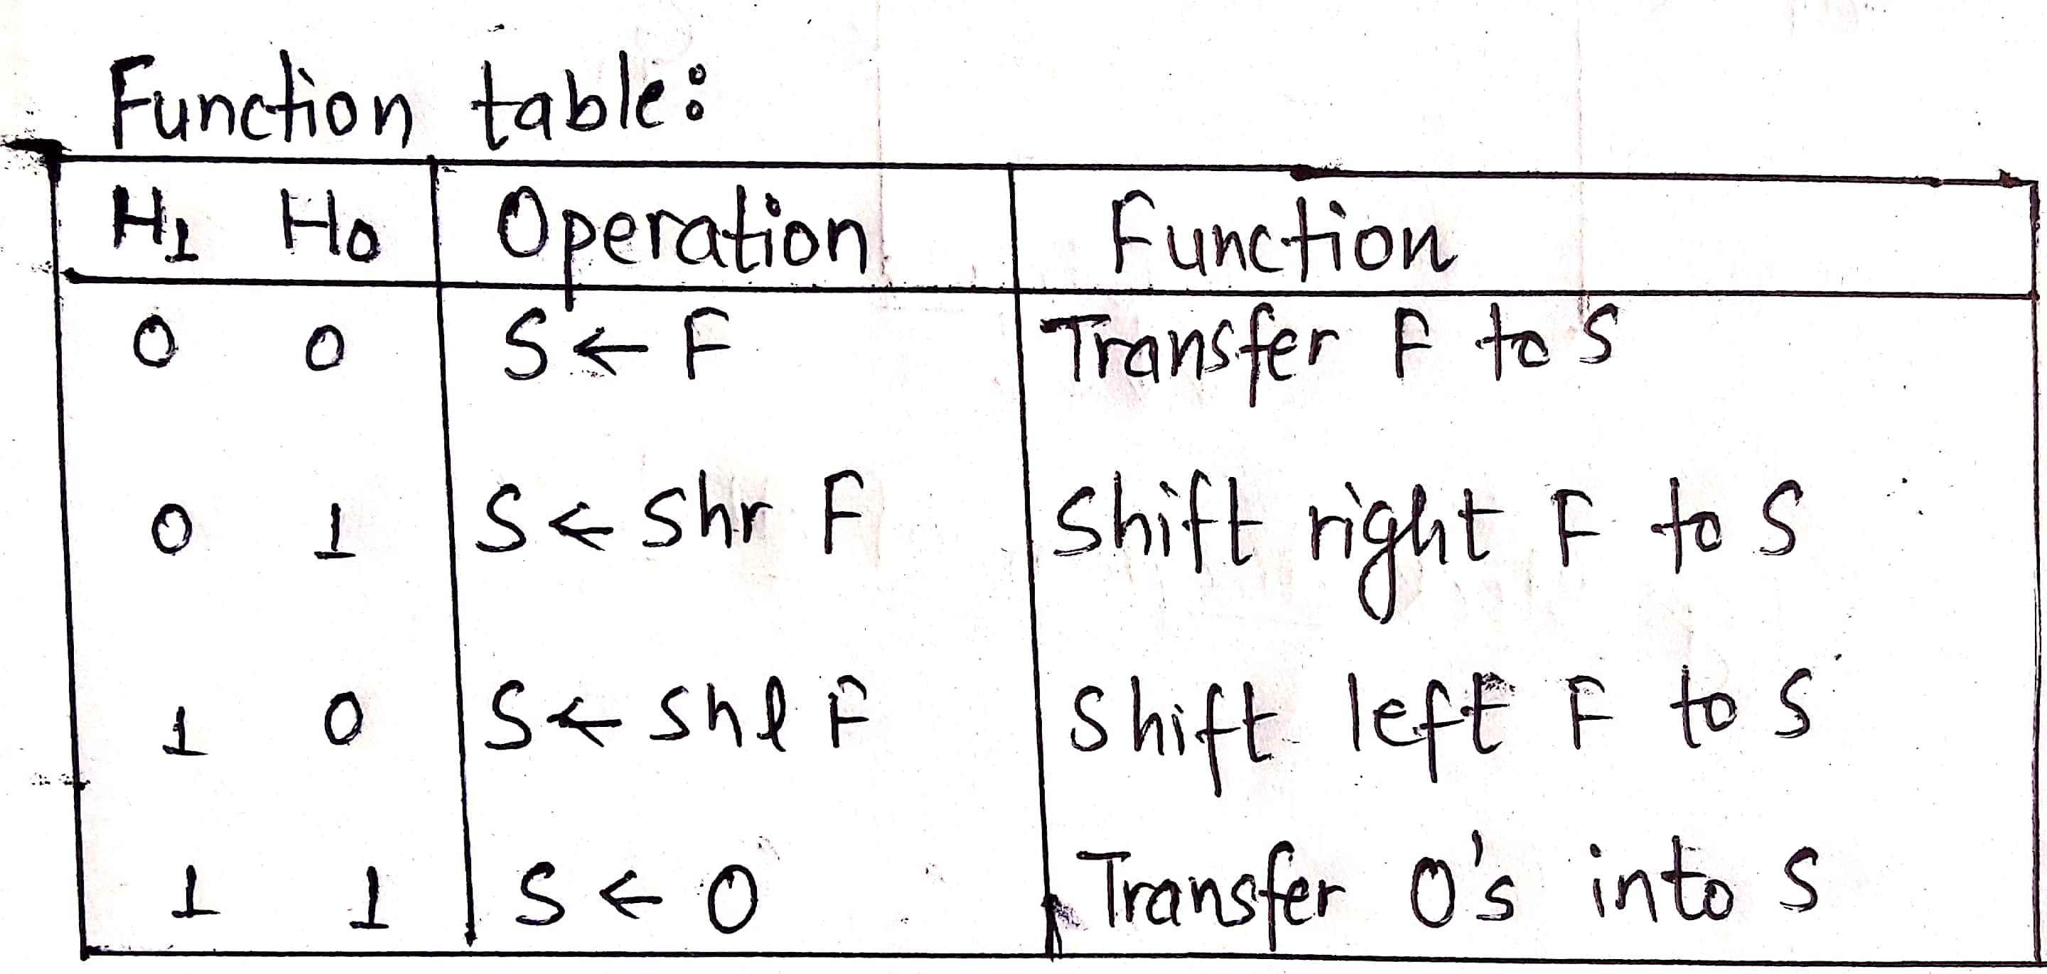
The function table of the 4 bit shifter is as:

Slide 12
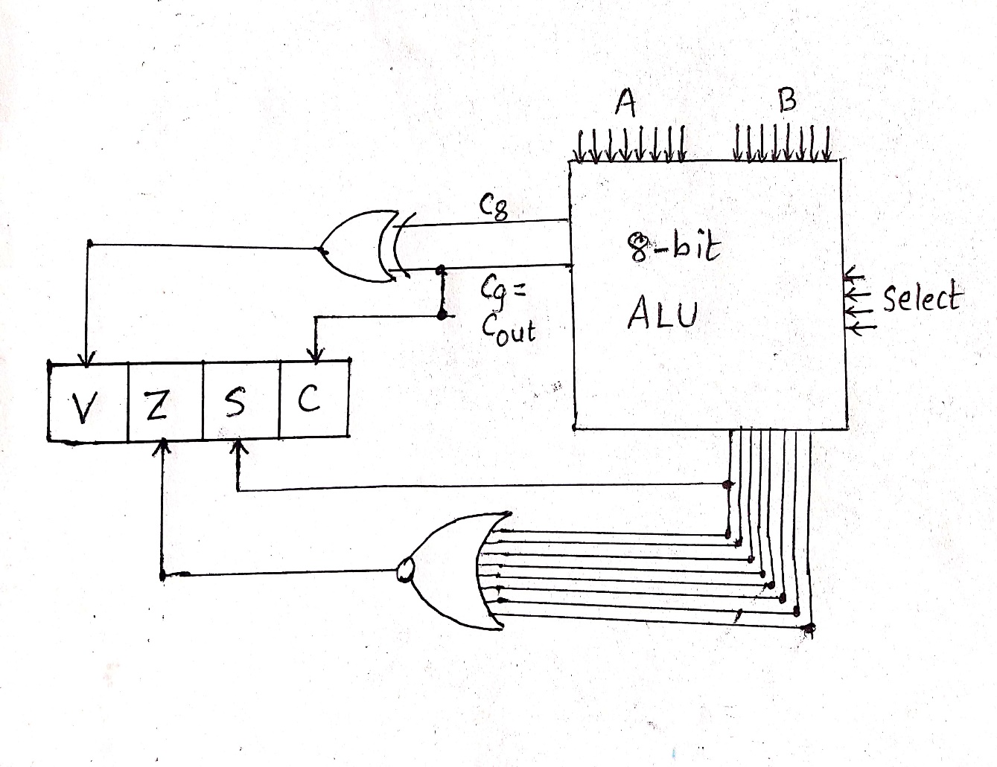
Status register
Bit C (carry) is set if o/t carry of ALU is 1. It is cleared if the o/p is 0.
Bit S (sign) is set if the highest order bit of the ALU o/p(the sign bit) is 1. It is cleared if the highest order bit is 0.
Bit Z(zero) is set if o/p of ALU contains all 0’s and cleared otherwise.
Bit V (overflow) is set if the XOR of C8 and C9 is 1. This is the condition of overflow when the numbers are in sign 2’s complement form.

Slide 13
Design of Accumulator
Some processor units distinguish one register from all others and call it an accumulator register.
Bidirectional register with parallel load connected to ALU.
The accumulator an its associated logic constitute a sequential circuit.
It consists n-stages and n-flip flops.
Register A is referred to as accumulator and sometime denoted by AC.
It is a multifunction register that can perform all the microoperations.
Microoperations of an AC depends on the particular processor

Slide 14
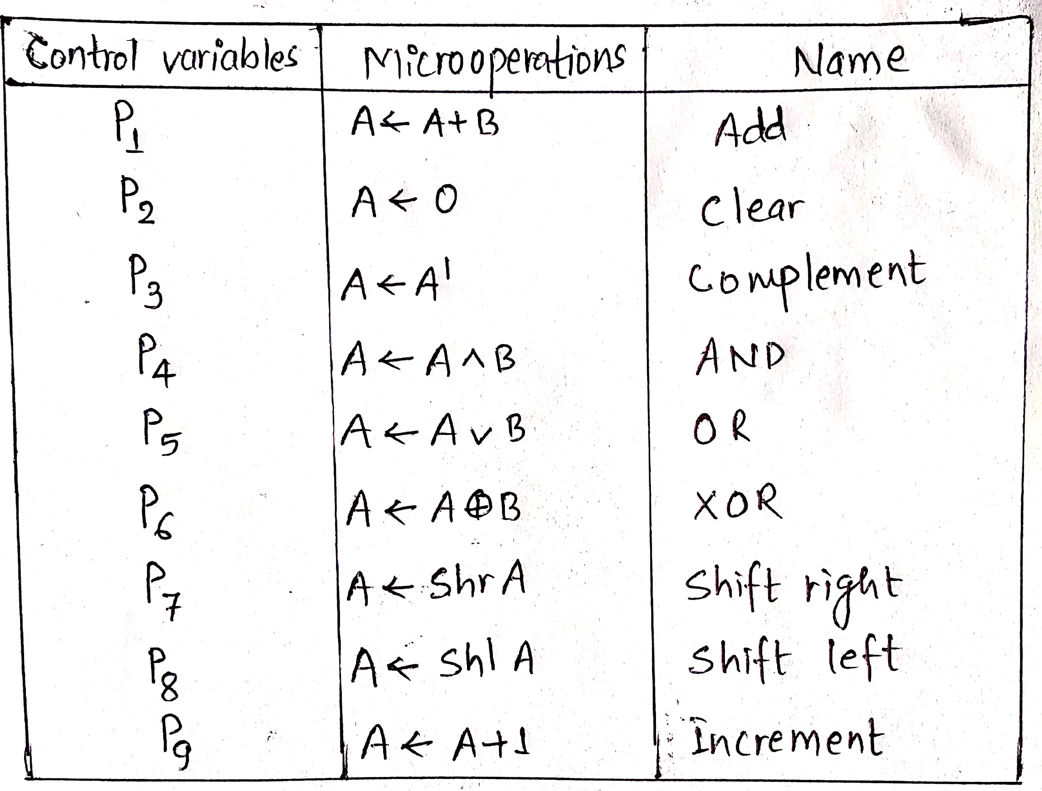
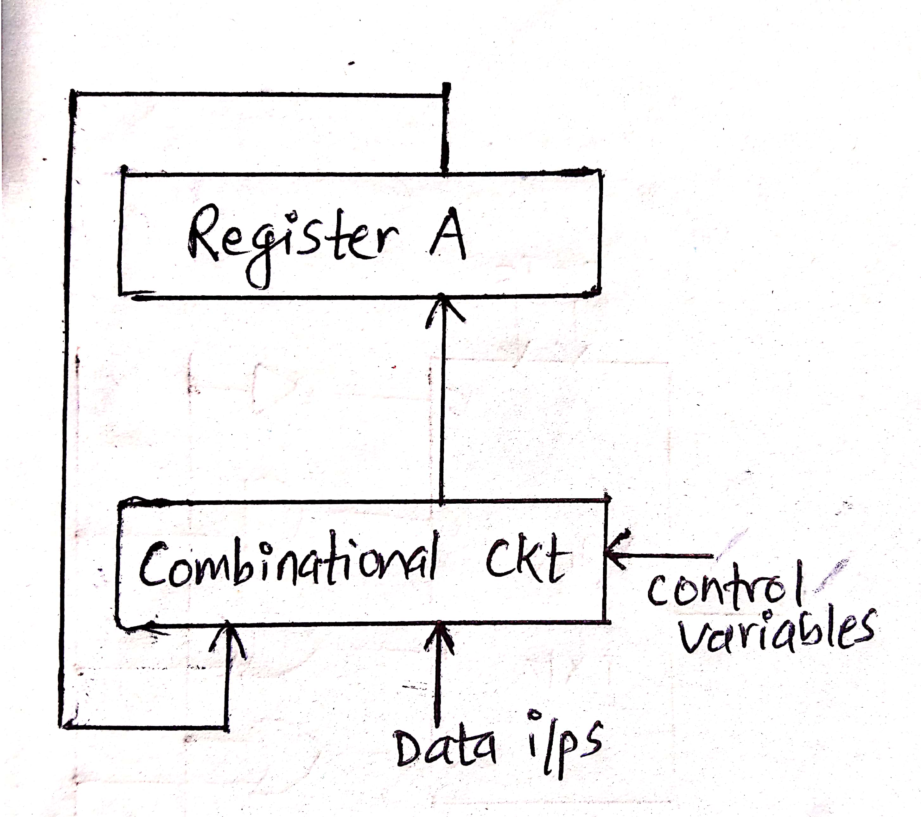
The block diagram and the different micro operations of an accumulator is as shown

Slide 15
Processor unit
Selection variables in a processor unit control the micro-operations executed within the processor during a CP.
Selection variables control the buses, ALU, shifter and the destination register.
Processor unit consists of registers and status register. The o/p of register go thru 2 MUX to select the i/p of ALU.
I/p data from external source are also selected by the same MUX.
O/p of ALU goes to the registers or external destination thru shifter.
There are 16 selection variables in the unit and their operations are controlled by a control word.

Slide 16
Processor unit continue…
16 bit control word, when applied, specifies a micro operation.
Bit of A selects source register for the i/p to left side of ALU and Bits of B selects the source register for i/p to right side of ALU.
D field selects the destination register.
F field together with Cin select a function for ALU.
H field selects the type of shift in the shifter.
All 16 bit control words are stored in control memory and each word specify a micro operation.
The sequence of control word is read from the memory, one at a time, to initiate a desired micro operation. This type of control operation is called micro programming.

Slide 17
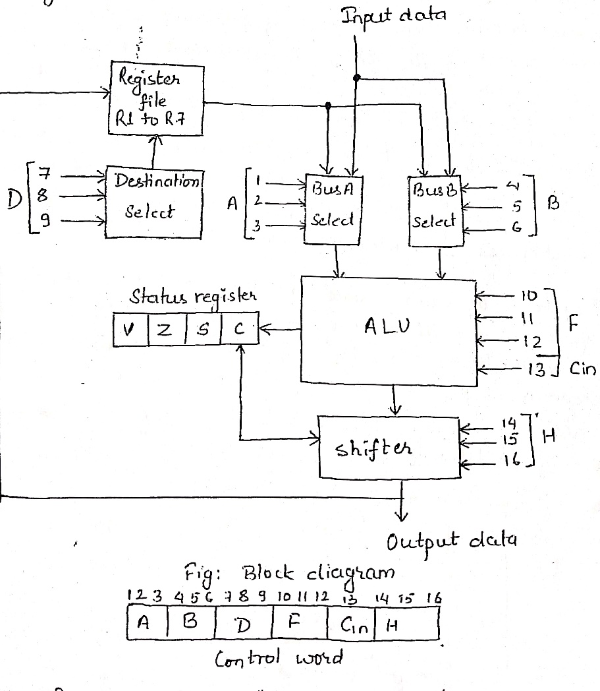
The diagram of a processor unit is shown below:

